Slide 1


Advanced Applications of Systems Modeling &Simulation
Dr. Xueping Li
University of Tennessee, Knoxville

Slide 2
Case Study #3
SP – PP System

Slide 3
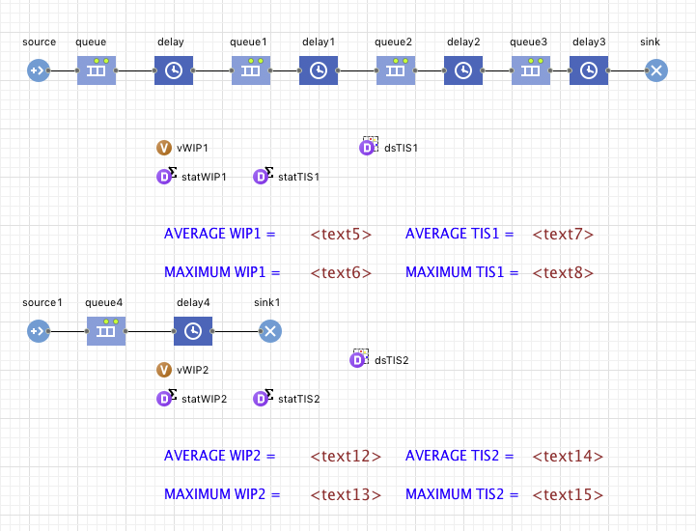

Slide 4
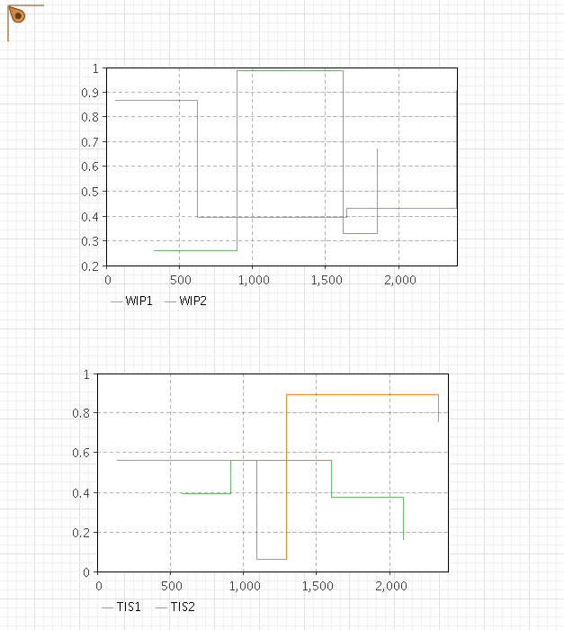

Slide 5
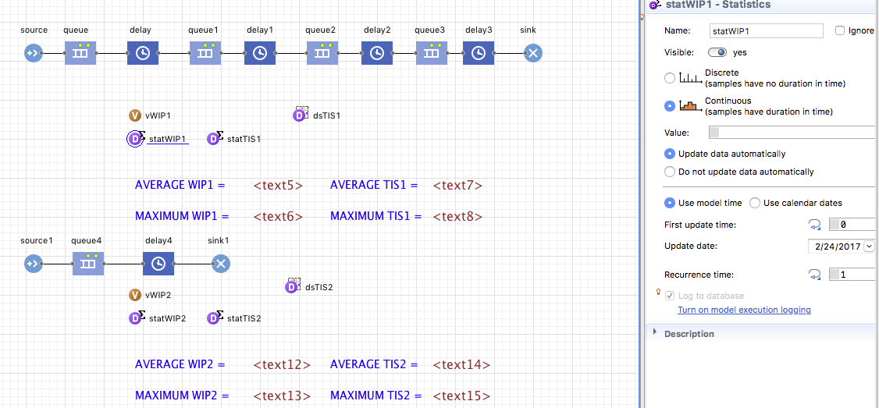

Slide 6
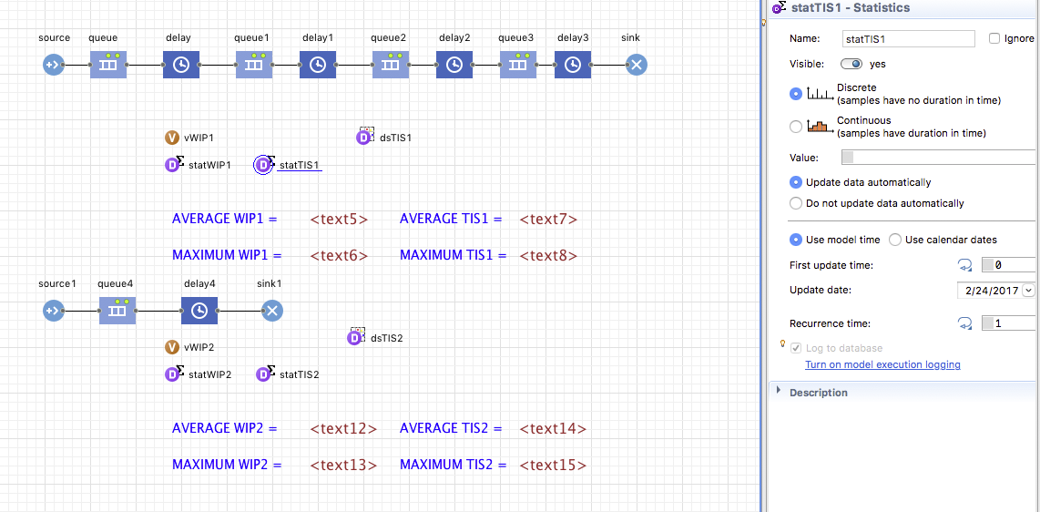

Slide 7
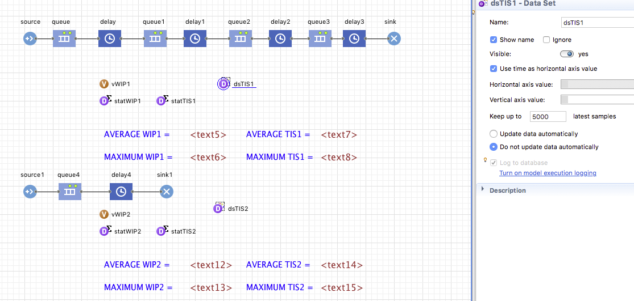

Slide 8
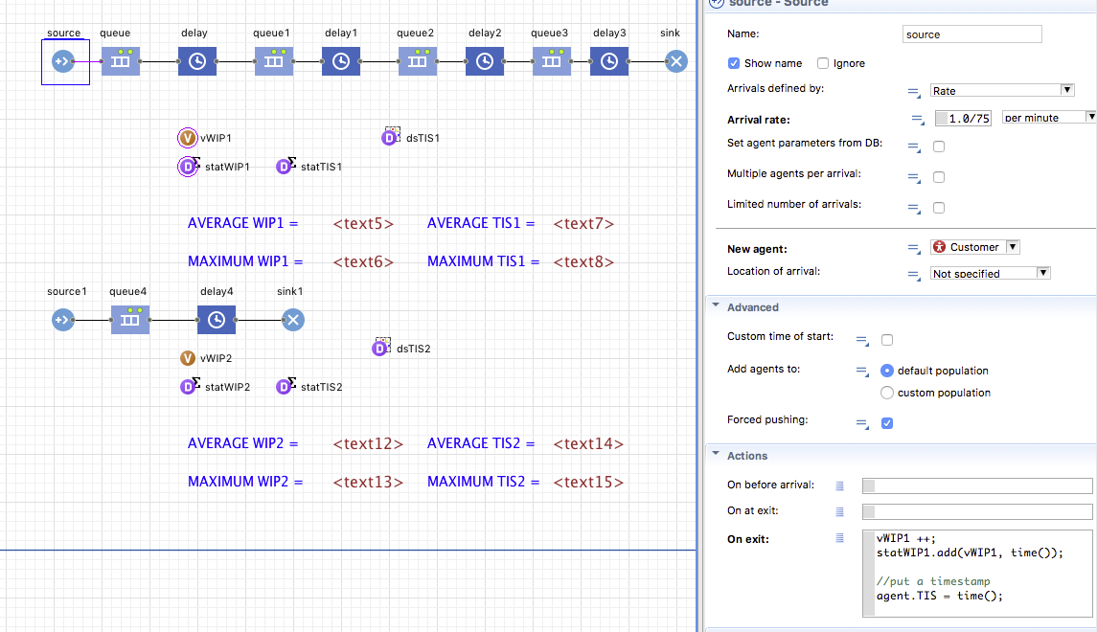

Slide 9
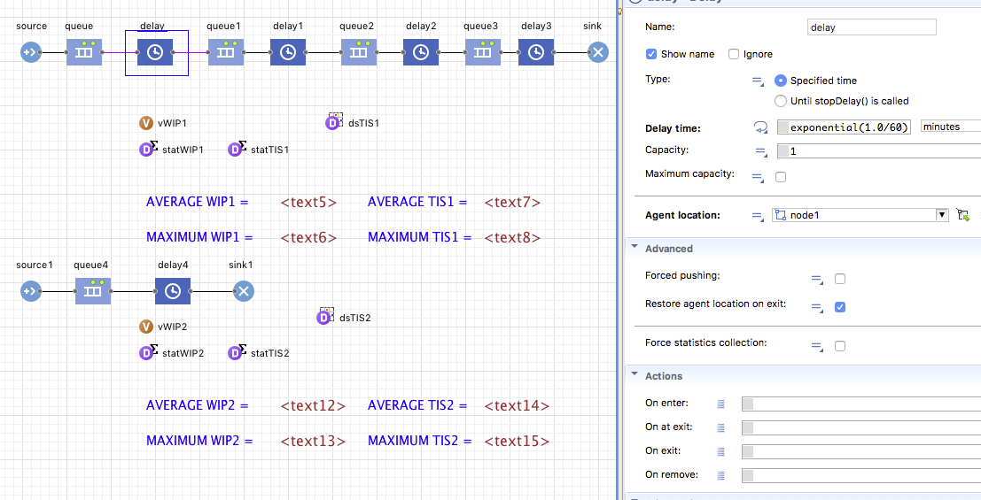

Slide 10
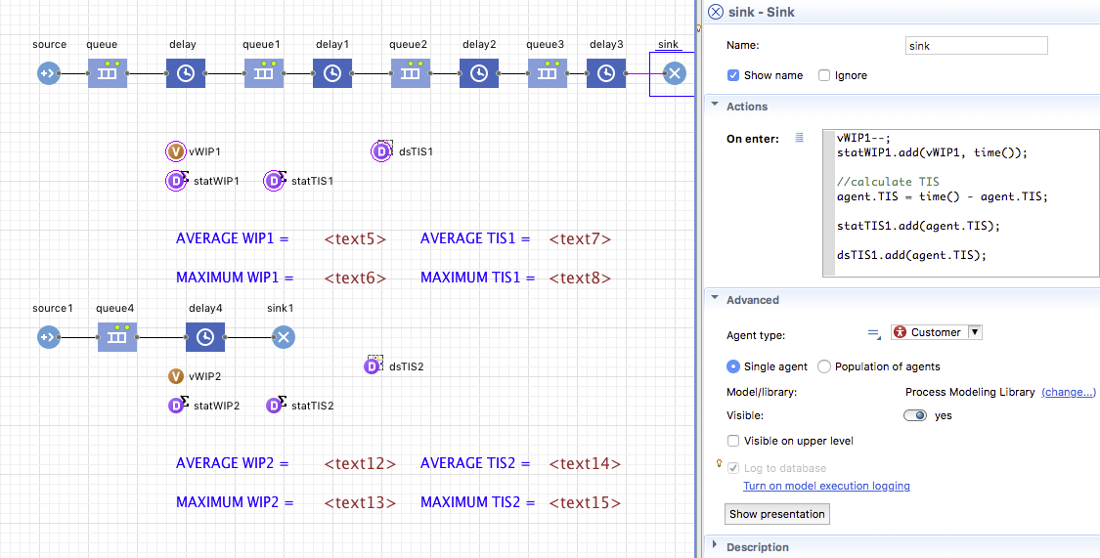

Slide 11
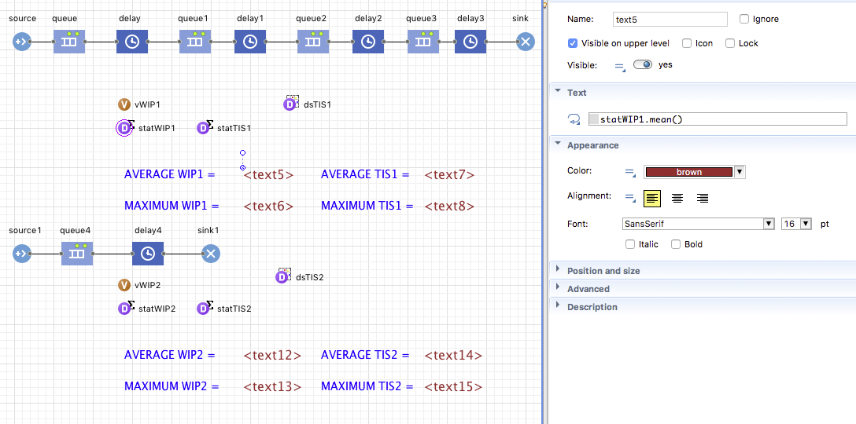

Slide 12
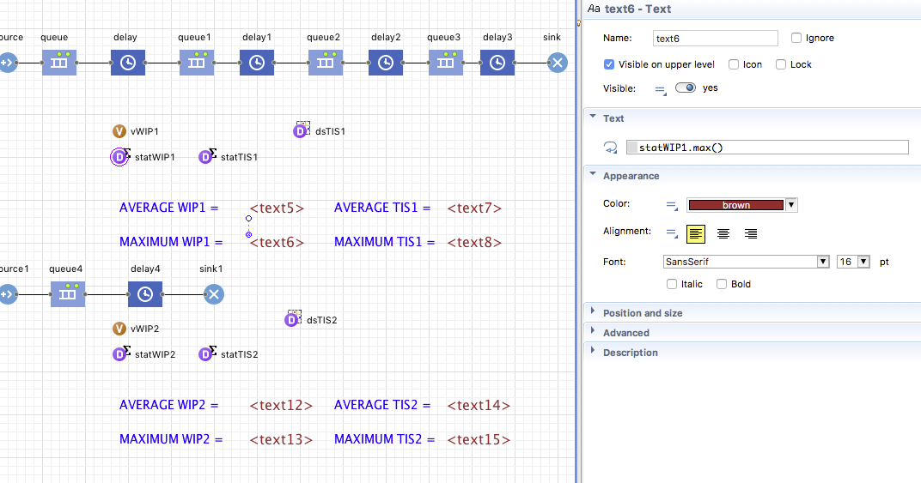

Slide 13
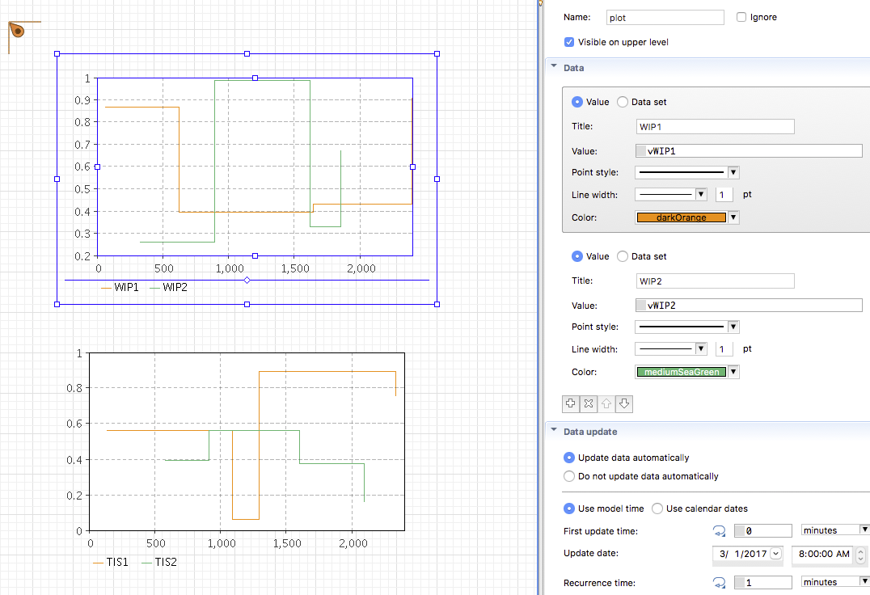

Slide 15
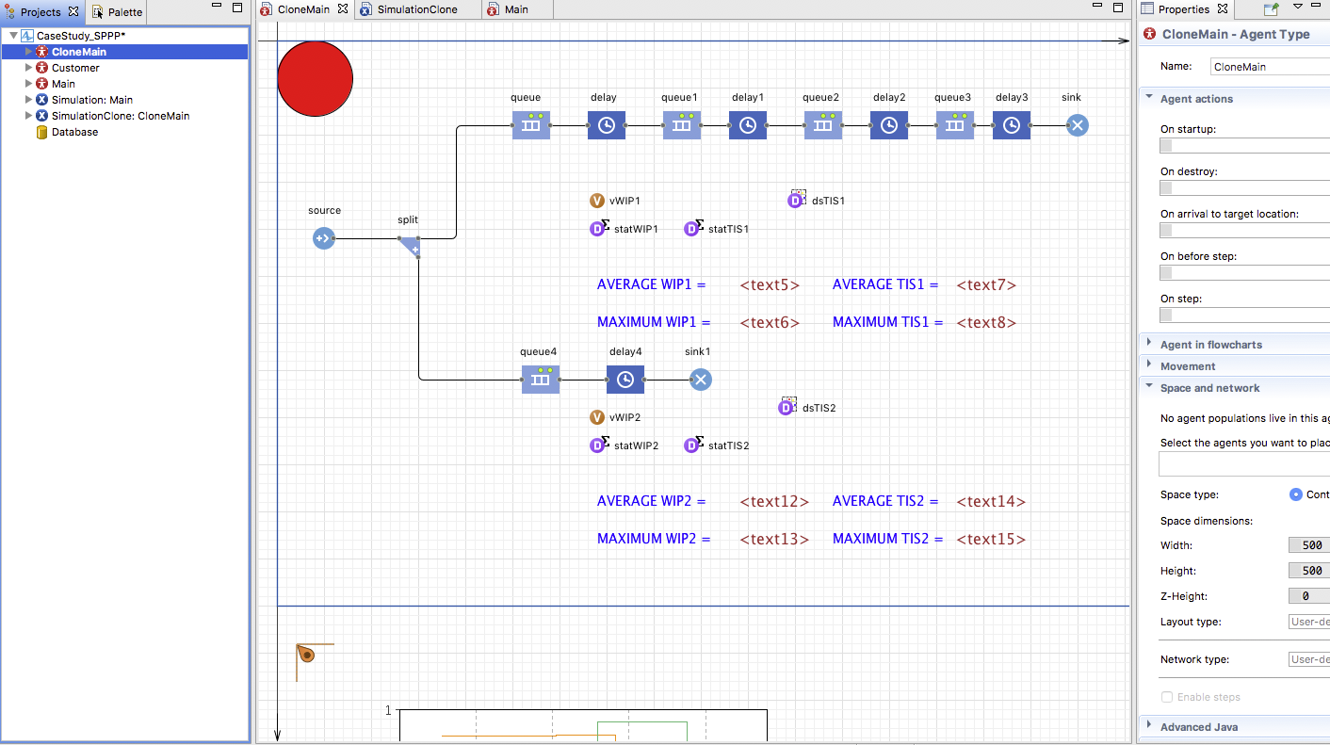

Slide 16
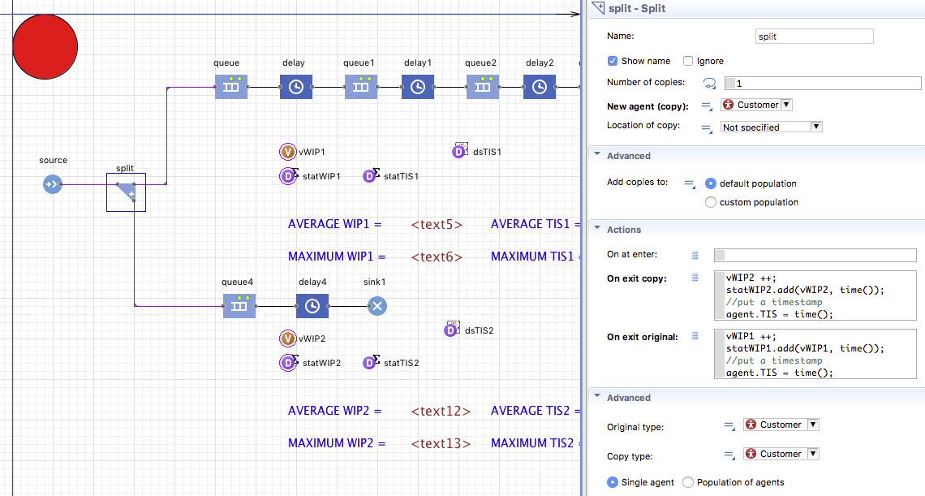

Slide 17
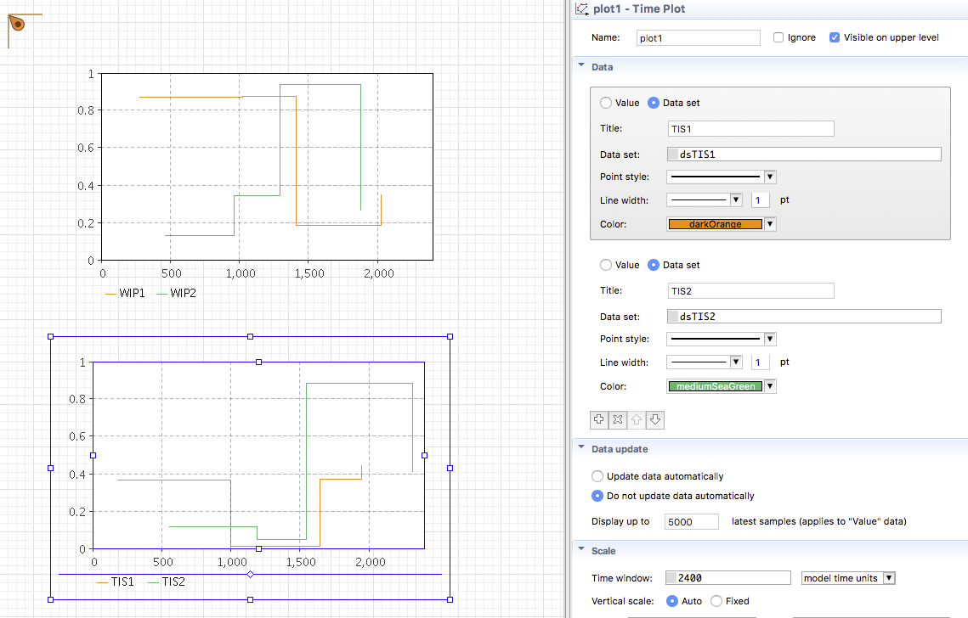

Slide 18
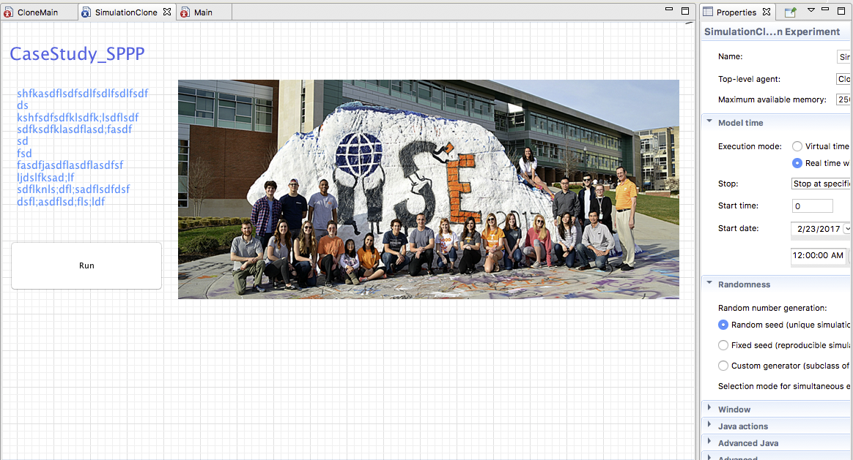

Slide 20
How many runs are needed??

Slide 21
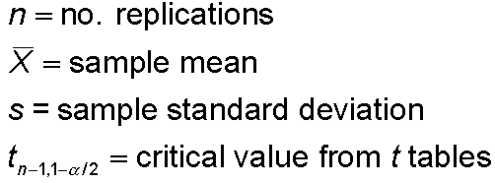


Half Width, Number of Replications
Prefer smaller confidence intervals — precision
Notation:
Confidence interval:
Half-width =
Can’t control t or s
Must increase n — how much?
Want this to be “small,” say
< h where h is prespecified

Slide 22



Half Width, Number of Replications (cont’d.)
Set half-width = h, solve for
Not really solved for n (t, s depend on n)
Approximation:
Replace t by z, corresponding normal critical value
Pretend that current s will hold for larger samples
Get
Easier but different approximation:
s = sample standard
deviation from “initial”
number n₀ of replications
n grows quadratically
as h decreases
h₀ = half width from “initial” number n₀ of replications

Slide 23
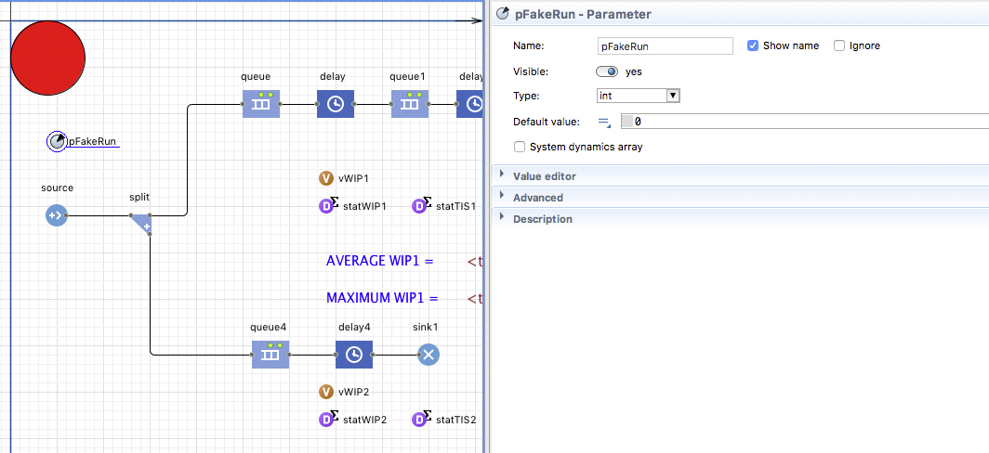
E.G. SP-PP Project:: 1) Define a parameter

Slide 24
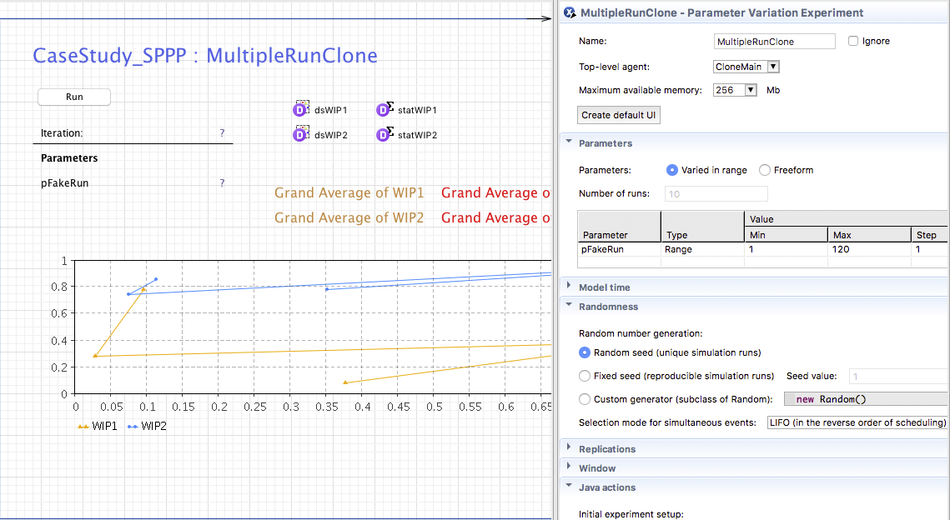
2) Create a Parameter Variation experiment

Slide 25
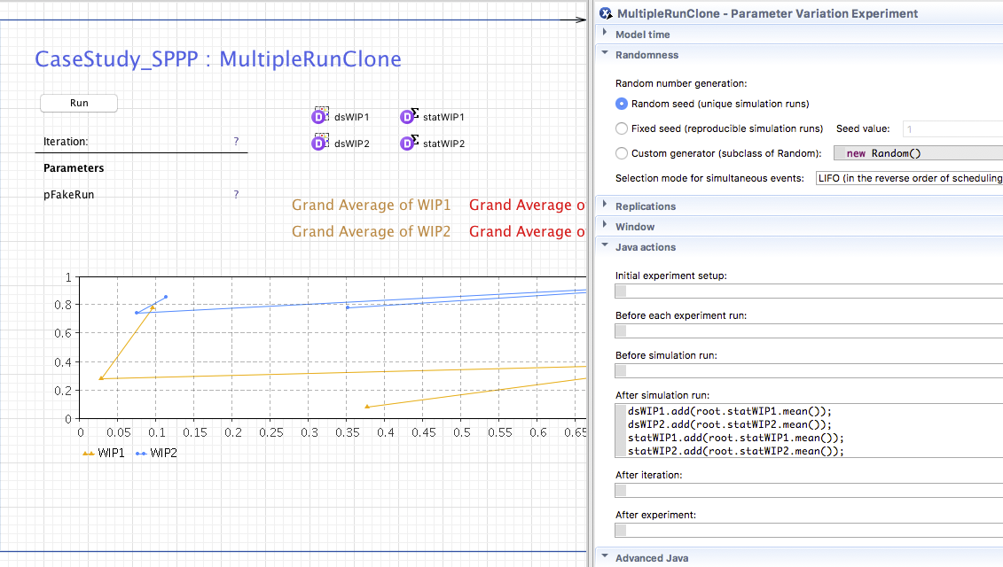
3) Collect data etc.

